Slide 1
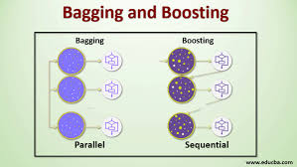
AGENDA
ENSEMBLE TECHNIQUES
BAGGING TECHNIQUE
BOOSTING TECHNIQUE
AND ITS TYPES

Slide 2
What is the use of Ensemble techniques/learning?
In classification and regression machine learning, we have used only 1 algorithm at once
Can we use multiple algorithms at once?
ENSEMBLE
GROUPING/
COMBINING

Slide 3
Ensemble Technique
We can use ensemble methods to combine different models in two ways: either using a single base learning algorithm that remains the same across all models (a homogeneous ensemble model) or using multiple base learning algorithms that differ for each model (a heterogeneous ensemble model).
Bagging
ENSEMBLE TECHNIQUES
Boosting

Slide 4
BAGGING
In Bagging technique , we create the models parallelly.
Bagging, also known as bootstrap aggregation. It is commonly used to reduce variance. In bagging, a random sample of data in a training set is selected with replacement. After several data samples are generated, these weak models are then trained independently, and depending on the type of task—regression or classification and gives the output as average or majority respectively.
In this, we can create the custom ensemble techniques
Random forest regressor
Types of Bagging
Random forest classifier

Slide 5
BAGGING(parallel models)
D>>d1
Test data
M1[Logistic regression]
output
Training dataset
0
D
Row sampling(d1)
f1 | f2 | f3 | y
M2[decision Tree]
1
Row sampling(d2)
majority
Row sampling (d3)
M3[Naive bayes]
0
Row sampling (d4)
M3[knn]
0

Slide 6
Random forest
What is the use of random forest?
DECISION TREE DISADVANTAGE
f1
Over fitting
Low bias
High variance
Low bias
Low variance

Slide 7
Random forest
f3
y
Training dataset
D(dataset)
M1(decision tree)
ROW SAMPLING+ column sampling
f1 | f2 | f3 | y
M2(decision tree)
ROW SAMPLING+ column sampling
ROW SAMPLING+ column sampling
M3(decision tree)
ROW SAMPLING+ column sampling
M4(decision tree)

Slide 8
Random forest Classifier
f3
y
Test dataset
D(dataset)
M1(decision tree)
0
ROW SAMPLING+ column sampling
f1 | f2 | f3 | y
M2(decision tree)
0
Output = majority
(i.e., 0)
ROW SAMPLING+ column sampling
ROW SAMPLING+ column sampling
M3(decision tree)
1
ROW SAMPLING+ column sampling
M4(decision tree)
0

Slide 9
Random forest Regressor
Bootstrap aggregator
f3
y
Test dataset
D(dataset)
M1(decision tree)
14
ROW SAMPLING+ column sampling
f1 | f2 | f3 | y
M2(decision tree)
15
Output =
average
ROW SAMPLING+ column sampling
ROW SAMPLING+ column sampling
M3(decision tree)
16
ROW SAMPLING+ column sampling
M4(decision tree)
15

Slide 10
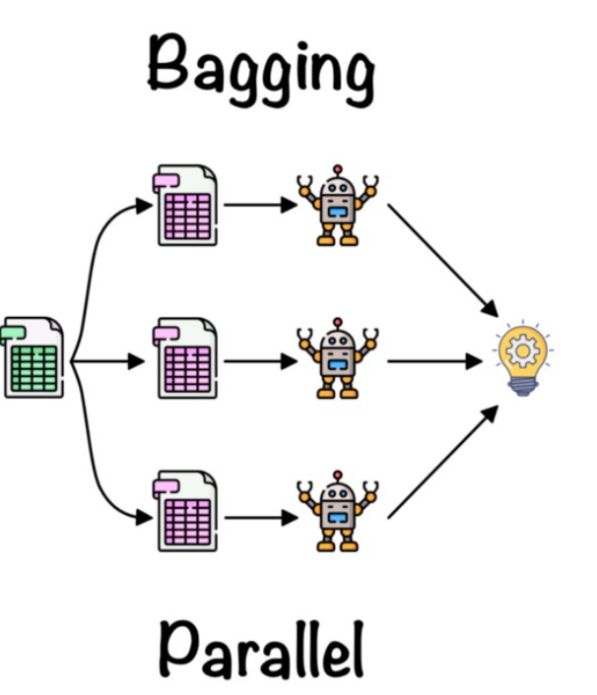
Advantages and Disadvantages of Random forest
Advantages:
Reduces the variance
Robust to outliers
Flexible in working even we have missing data or imbalance data
Normalization is not required
Disadvantages:
It may result in high bias if it is not modelled properly and thus may result in underfitting.
Since we must use multiple models, it becomes computationally expensive and may not be suitable in various use cases.

Slide 11


Boosting(sequential models)
Training data
Weak learners
Weak learners
output
Strong learners

Slide 12
Boosting
Boosting is an algorithm that helps in reducing variance and bias in a machine learning ensemble. The algorithm helps in the conversion of weak learners into strong learners by combining N number of learners.
ADABOOST
GRADIENT BOOSTING
TYPES OF BOOSTING
XG BOOST

Slide 13
Boosting- ADABOOST
Binary classification
F1 | F2 | F3 | F4 | Y (output) | Weights (1/n)
- | - | - | - | yes | 1/7
- | - | - | - | No | 1/7
- | - | - | - | - | 1/7
- | - | - | - | - | 1/7
- | - | - | - | - | 1/7
- | - | - | - | - | 1/7
- | - | - | - | - | 1/7
STEP 1:
initializing weights for each row
Formula=1/number of observations

Slide 14
Boosting- ADABOOST
Number of stumps = number of features
Step2: creation of base learners(decision trees) of single depth called as stumps.
F1
F2
F3
Lower entropy + high info gain➔ feature selection as base learner

Slide 15
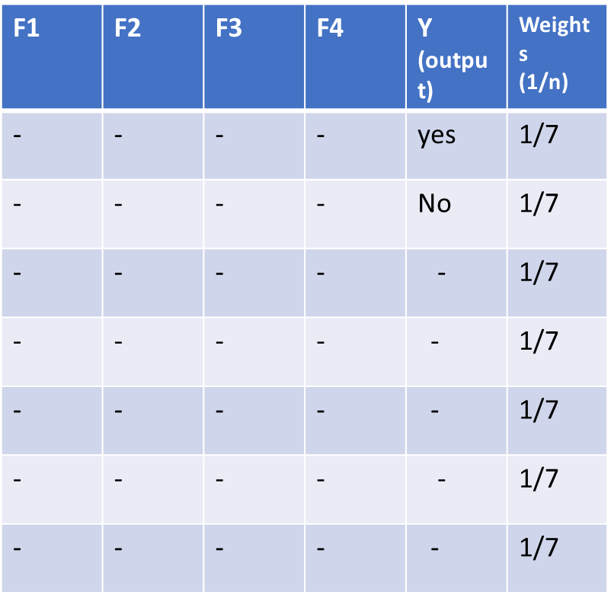
Boosting- ADABOOST
Step 3: Total error calculation.
Total error= weights of wrongly predicted
Total error=1/7
misclassification

Slide 16
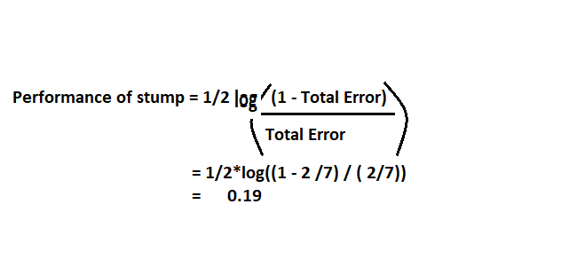
Boosting- ADABOOST
Step4: performance of stump calculation
Formula= performance of stump=1/2 loge((1-TE)/TE))
½ loge((1-1/7)/1/7)➔ 0.895

Slide 17
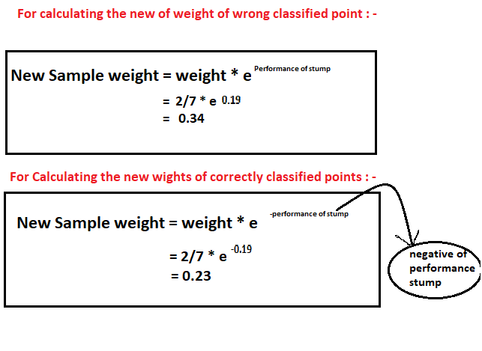

Boosting- ADABOOST
STEP 5:
Updating weights
For correct prediction: value gets reduced
For wrong prediction : value get increased
Binary classification
F1 | F2 | F3 | F4 | Y (output) | Weights (1/n) | Updating weights
- | - | - | - | yes | 1/7 | 0.05
- | - | - | - | No | 1/7 | 0.05
- | - | - | - | - | 1/7 | 0.05
- | - | - | - | - | 1/7 | 0.349
- | - | - | - | - | 1/7 | 0.05
- | - | - | - | - | 1/7 | 0.05
- | - | - | - | - | 1/7 | 0.05
Correctly predicted=1/7*e-(0.895)=0.05
wrongly predicted=1/7*e(0.895)= 0.349

Slide 18
Boosting- ADABOOST
Binary classification
F1 | F2 | F3 | F4 | Y (output) | Weights (1/n) | Updating weights | Normalized weights
- | - | - | - | yes | 1/7 | 0.05 | 0.05/0.649= 0.07
- | - | - | - | No | 1/7 | 0.05 | 0.07
- | - | - | - | - | 1/7 | 0.05 | 0.07
- | - | - | - | - | 1/7 | 0.349 | 0.349/0.649= 0.537
- | - | - | - | - | 1/7 | 0.05 | 0.07
- | - | - | - | - | 1/7 | 0.05 | 0.07
- | - | - | - | - | 1/7 | 0.05 | 0.07
STEP 6:
normalization
Updated weight/ total of updated weights
=
0.05/0.649

Slide 19
Boosting- ADABOOST
STEP 7:
Buckets list creation
Binary classification
F1 | F2 | F3 | F4 | Y (output) | Weights (1/n) | Updating weights | Normalized weights | Buckets list
- | - | - | - | yes | 1/7 | 0.05 | 0.05/0.649= 0.07 | 0→0.07
- | - | - | - | No | 1/7 | 0.05 | 0.07 | 0.07→0.14
- | - | - | - | - | 1/7 | 0.05 | 0.07 | 0.14→0.21
- | - | - | - | - | 1/7 | 0.349 | 0.349/0.649= 0.537 | 0.21→0.747
- | - | - | - | - | 1/7 | 0.05 | 0.07 | 0.747→0.751
- | - | - | - | - | 1/7 | 0.05 | 0.07 | 0.751→0.821
- | - | - | - | - | 1/7 | 0.05 | 0.07 | 0.821→0.891
0.07+0.07➔0.14

Slide 20
Boosting- ADABOOST classifier
input
Base learner
Base learner
Base learner
Base learner
Output [0]
Output
[0]
Output
[1]
Output
[0]
Majority ➔ output➔0

Slide 21
Boosting- ADABOOST Regressor
input
Base learner
Base learner
Base learner
Base learner
Output [10]
Output
[10]
Output
[12]
Output
[13]
Average

Slide 22
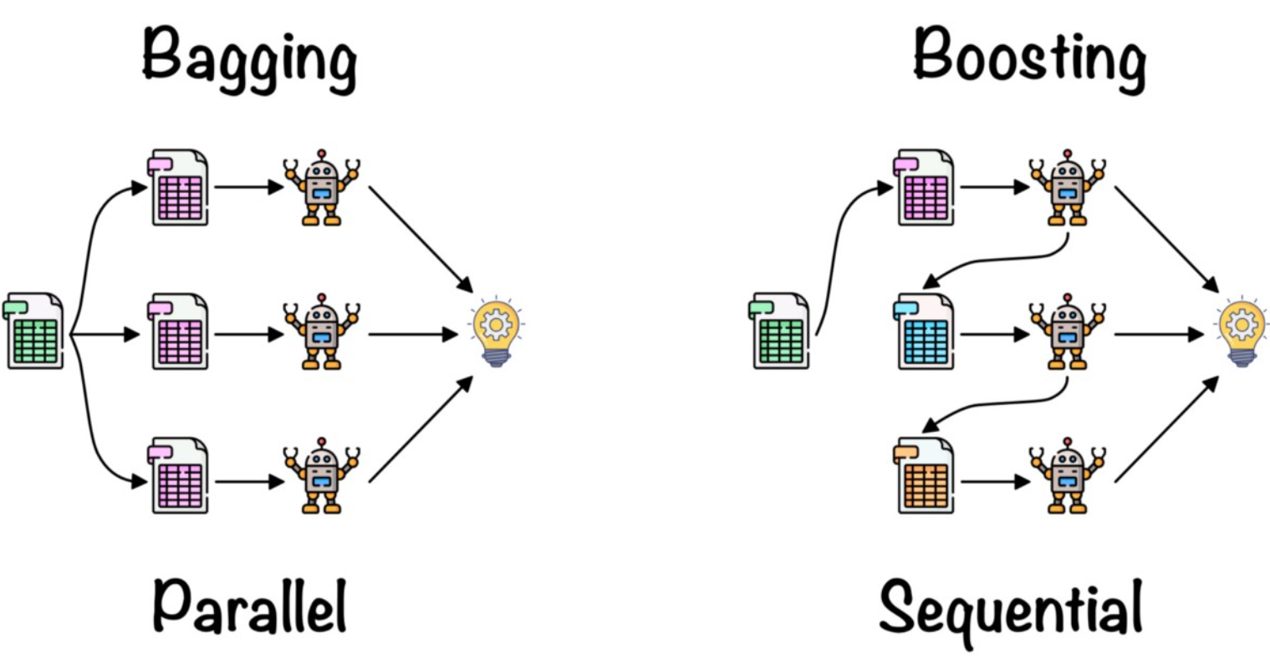
Advantages and Disadvantages of boosting
Advantages:
Prediction capability is efficient than bagging
No parameters to tune
No need of prior knowledge of weak learners' model
Disadvantages:
Time complexity
Hard to implement in real time platform
Computationally expensive

